Slide 1
Representation with Logic (Chapters 7-9)
Dr. Shengquan Wang
Most slides are adopted from
Artificial Intelligence: A Modern Approach, 4th ed. by Stuart Russell (UC Berkeley) and Peter Norvig (Google).
Peter Norvig and Sebastian Thrun for Intro to Artificial Intelligence at Udacity.
Tian-Li Yu for Artificial Intelligence - Search & Logic at Coursera.

Slide 2
AI Design Space
Knowledge Representation
Logic (Sentences)
Environment
Stochastic, Partial observable
Variables (Words)
Deterministic,
Full observable
Agent Design
Goal-based/ Utility-based
Reflex

Slide 3
Outline
Knowledge-based Agents

Slide 4

A Knowledge-based Agent
Agent
Query
Inference engine
KB
Conclusion
Knowledge base (KB):
Stores knowledge, which is represented by sentences in a particular knowledge representation language.
Inference engine:
Draws conclusions in new sentences to answer questions, solve problems, or suggest actions to perform to achieve goals.
Notes:
https://www.cs.utexas.edu/~mooney/cs343/slide-handouts/logic.4.pdf

Slide 5
Knowledge Representation Language
sentences
sentence
Entails
Representation
Environment
Semantics
Semantics
Follows
facts
fact
Syntax defines the sentences in the language (how to group together objects=vocabulary to form a sentence).
Semantics defines the “meaning” of sentences, i.e., define truth of a sentence in a world.
Logical inference (deduction) derives new sentences in the language from existing ones.

Slide 6
Knowledge Representation Language
Propositional (discrete) logic
First order logic

Slide 7
Outline
Knowledge-based Agents
Propositional Logic
Basics

Slide 8
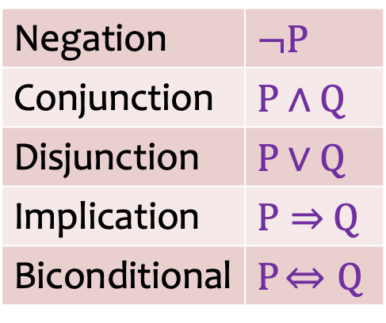
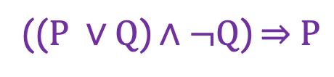
Propositional Logic: Syntax
Boolean proposition symbol:
P
Q
Logical connectives:
The atomic sentences consist of a single Boolean proposition symbol.
Complex sentences are constructed from atomic sentences, using parentheses and logical connectives.
Negation | $$¬P$$
Conjunction | $P$ $∧$ $Q$
Disjunction | $P$ $∨$ $Q$
Implication | $P⇒$ $Q$
Biconditional | $P$ $⇔Q$
(($P ∨Q$) $∧¬Q$) $⇒$ $P$
Notes:
Biconditional = bidirectional implication.
Remember, for implication: implication is always true if left-side operand is false (because if entire implication is false→when left operand is false, then output is always true).
Else, if left-side is true, then right operand determines the final output (true or false).

Slide 9

Semantics: Truth Tables for Connectives
P | Q | $¬$P | P$∧$Q | P$∨$Q | P$⇒$Q | P$⇔$Q
F | F | T | F | F | T | T
F | T | T | F | T | T | F
T | F | F | F | T | F | F
T | T | F | T | T | T | T

Slide 10
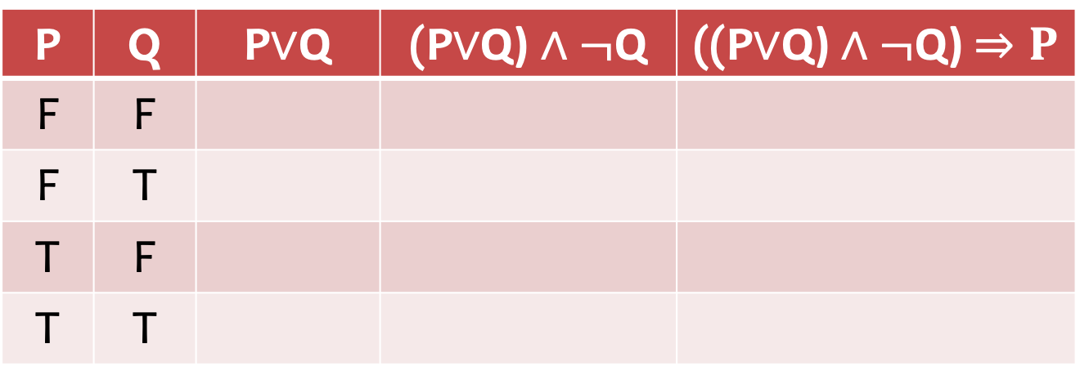
Quiz
P | Q | P$∨$Q | (P$∨$Q) $∧¬$Q | ((P$∨$Q) $∧¬$Q) $⇒P$
F | F
F | T
T | F
T | T

Slide 11
Quiz: Solution
P | Q | P$∨$Q | (P$∨$Q) $∧¬$Q | ((P$∨$Q) $∧¬$Q) $⇒P$
F | F
F | T
T | F
T | T
F
F
T
T
F
T
T
T
T
T
F
T

Slide 12
Logical Equivalence
(P ∧ Q) ≡ (Q ∧ P) commutativity of ∧
(P ∨ Q) ≡ (Q ∨ P) commutativity of ∨
((P∧Q)∧R) ≡ (P∧(Q∧R)) associativity of ∧
((P∨Q)∨R) ≡ (P∨(Q∨R)) associativity of ∨
¬(¬P) ≡ P double-negation elimination
(P ⇒ Q) ≡ (¬Q ⇒ ¬P) contraposition
(P ⇒ Q) ≡ (¬P ∨ Q) implication elimination
(P ⇔ Q) ≡ ((P ⇒ Q) ∧ (Q ⇒ P)) biconditional elimination
¬(P∧Q) ≡ (¬P∨¬Q) De Morgan
¬(P∨Q) ≡ (¬P∧¬Q) De Morgan
(P∧(Q∨R)) ≡ ((P∧Q)∨(P∧R)) distributivity of ∧ over ∨
(P∨(Q∧R)) ≡ ((P∨Q)∧(P∨R)) distributivity of ∨ over ∧
Notes:
We can prove, for example, contraposition logical equivalence above by contradiction.

Slide 13
Quiz
P | Q | P ⇒ Q | ¬Q ⇒ ¬P | ¬P ∨ Q
F | F
F | T
T | F
T | T

Slide 14
Answer
P | Q | P ⇒ Q | ¬Q ⇒ ¬P | ¬P ∨ Q
F | F
F | T
T | F
T | T
T
T
T
T
T
T
F
F
F
T
T
T
Notes:
Above, brute force approach to prove equivalences of outcomes for all possible P and Q combinations.

Slide 15
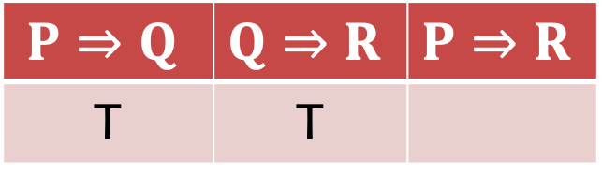
Quiz: Proving Chain Rule
$$P⇒Q$$ | $$Q⇒R$$ | $$P⇒R$$
T | T
T

Slide 16

Answer: Proof of Chain Rule
P | Q | R | $$P⇒Q$$ | $$Q⇒R$$ | $$P⇒R$$
F
T
T
T
T
T
T
T
T
T
Notes:
Notice how we are proving chain rule: Q and R are never known, but we can still determine P→R since we know P→Q and Q→R.

Slide 17
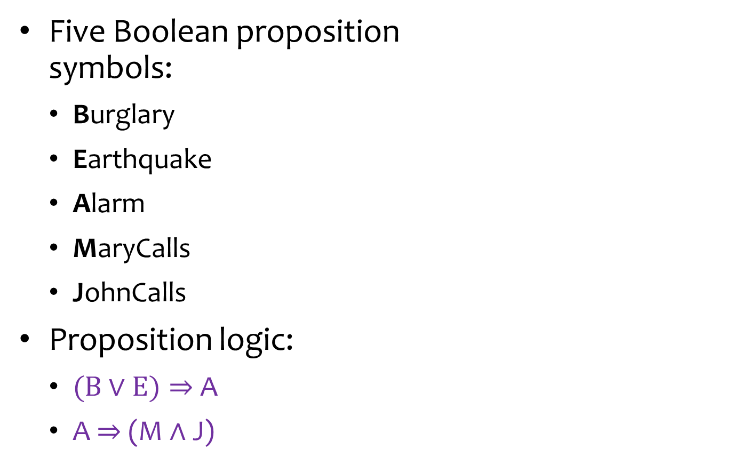
Example: Alarm
Five Boolean proposition symbols:
Burglary
Earthquake
Alarm
MaryCalls
JohnCalls
Proposition logic:
($B$ $∨$ $E)⇒$ A
A $⇒$ (M $∧$ J)
Burglary
Earthquake
Alarm
MaryCalls
JohnCalls
Notes:
With implication statements, we normally do not care about left side when it is false (the especially important thing is when left operand is true and thus the implication is true, and thus we can determine the output based on right operand); but for the purposes of propositional logic analysis, we have to establish that the statement is true whenever the left operand is false.

Slide 18
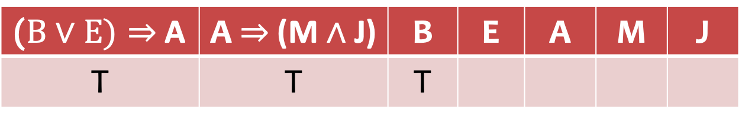
Quiz
Burglary
Earthquake
Alarm
MaryCalls
JohnCalls
($B$ $∨$ $E)⇒$ A | A $⇒$ (M $∧$ J) | B | E | A | M | J
T | T | T

Slide 19
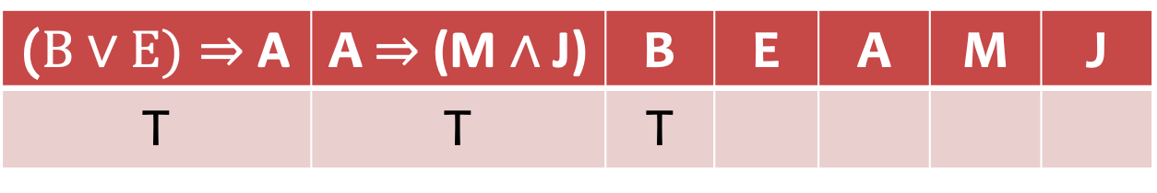
Answer
Burglary
Earthquake
Alarm
MaryCalls
JohnCalls
($B$ $∨$ $E)⇒$ A | A $⇒$ (M $∧$ J) | B | E | A | M | J
T | T | T
?
T
T
T

Slide 20
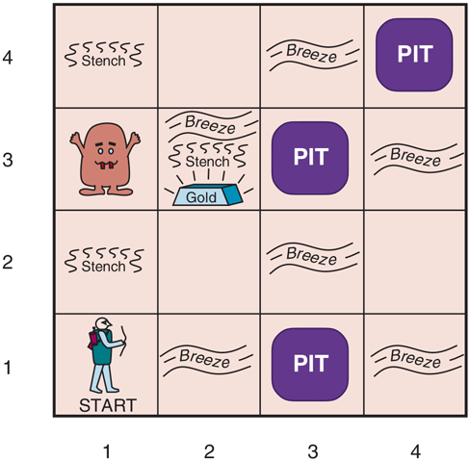
Example: Wumpus World
PerformanceMeasure | gold: +1000 death (into a pit or eaten by wumpus): -1000 1 step: -1 using the arrow: -10
Environment | (1,1): cave entrance and exit squares adjacent to wumpus are smelly squares adjacent to pit are breezy glitter iff gold is in the same square walk into a wall and bump shoot directly at wumpus no matter how far, it will scream and die, and the only arrow will be used up grab/release the gold if in same square
Actuators | Left/right turn; forward; grab, release; shoot
Sensors | smell; breeze; glitter; bump; scream

Slide 21
Wumpus World Characterization
Partially observable: only local perception
Deterministic: outcomes exactly specified
Sequential: at the level of actions
Static: Wumpus and Pits do not move
Discrete: grid
Single-agent: Wumpus is essentially a natural feature

Slide 22

Exploring a Wumpus World
OK
OK
OK
Notes:
In first square, no smell or breeze, so we are free to move in any direction.

Slide 23
Exploring a Wumpus World
?Pit
OK
Breeze
?Pit
OK
OK

Slide 24
Exploring a Wumpus World
?Pit
OK
Breeze
?Pit
?Wumpus
OK
OK
Smell
?Wumpus
Notes:
Now we know Wumpus is to the right of current location, and we know that the location that might have had a pit does not since there is no breeze, and we know Wumpus is to the right since in previous square there was no smell (but a breeze, but the breeze was coming from north).
Better not to shoot Wumpus even though we know it is to the right because it costs 10, and steps only cost 1.

Slide 25
Exploring a Wumpus World
?Pit
Pit
OK
Breeze
?Pit
?Wumpus
OK
OK
OK
Smell
?Wumpus
Wumpus

Slide 26
Exploring a Wumpus World
Pit
OK
OK
Breeze
OK
OK
OK
OK
Smell
Wumpus

Slide 27
Exploring a Wumpus World
Pit
OK
OK
Breeze
OK
OK
Breeze
Glitter
Smell
OK
OK
Smell
Wumpus

Slide 28
Given a KB, how can we check if an inference is true?
Notes:
Think about how this crosses over with inference in games (like Sudoku).

Slide 29
Outline
Knowledge-based Agents
Propositional Logic
Basics
Propositional Theorem Proving

Slide 30
A Knowledge-based Agent
Agent
Query
Inference engine
KB
Conclusion
Knowledge base (KB):
Stores knowledge, which is represented by sentences in a particular knowledge representation language.
Inference engine:
Draws conclusions in new sentences to answer questions, solve problems, or suggest actions to perform to achieve goals.
Notes:
https://www.cs.utexas.edu/~mooney/cs343/slide-handouts/logic.4.pdf

Slide 31
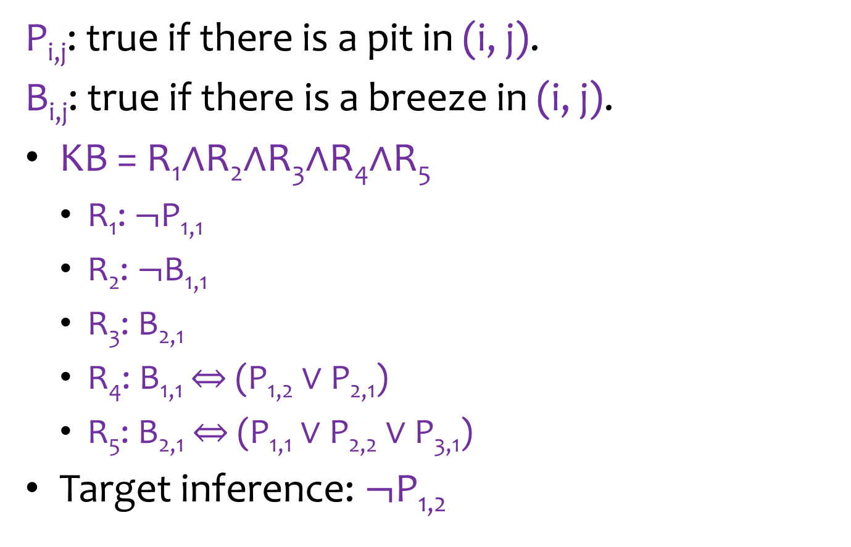



Wumpus World Sentences
P_{i,j}: true if there is a pit in (i, j).
B_{i,j}: true if there is a breeze in (i, j).
KB = R₁$∧$R₂$∧$R₃$∧$R₄$∧$R₅
R₁: $¬$P_{1,1}
R₂: $¬$B_{1,1}
R₃: B_{2,1}
R₄: B_{1,1} $⇔$ (P_{1,2} $∨$ P_{2,1})
R₅: B_{2,1} $⇔$ (P_{1,1} $∨$ P_{2,2} $∨$ P_{3,1})
Target inference: $¬\text{P}\text{1,2}$
4
3
2
B_{2,1}
$¬$P_{1,1}
1
$$¬\text{P}\text{1,2}$$
$¬$B_{1,1}
1
2
3
4
Notes:
R_i == a rule that is in the knowledge base.
Each step you make observations, update the knowledge base, make new inferences (similar to Bayes Rule, but we are using a discrete framework via propositional logic).
Use rule 2 and rule 4 to prove target inference is true.

Slide 32




Proving through Enumeration
4
3
If KB is true in row, $\text{P}\text{1,2}$ is false.
2
B_{2,1}
O(2^{n}) for n symbols.
$¬$P_{1,1}
1
$$¬\text{P}\text{1,2}$$
$¬$B_{1,1}
1
2
3
4
Notes:
Using brute force: this situation has 12 variables, each variable is binary; thus 2^12 = about 4k combinations; notice this is exponential, where the exponent is the number of variables and base is all possible values a variable can take (in this case T or F); thus with 100 variables, we get 2^100 variables! This is an infeasible approach as you see because number of combinations to check would be on the order of exponential.

Slide 33
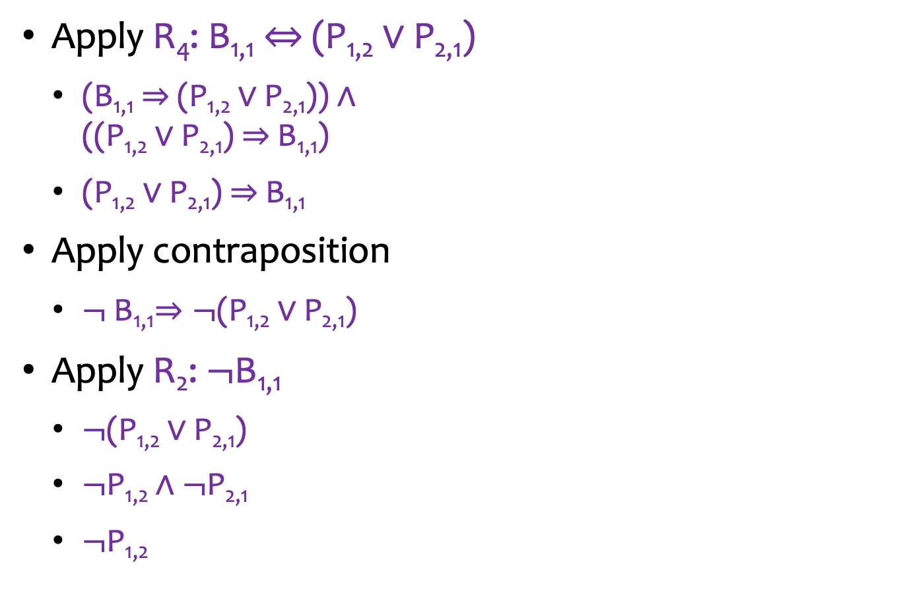

Propositional Theorem Proving
Apply R₄: B_{1,1} $⇔$ (P_{1,2} $∨$ P_{2,1})
(B_{1,1}$⇒$(P_{1,2} $∨$ P_{2,1})) $∧$ ((P_{1,2} $∨$ P_{2,1}) $⇒$B_{1,1})
(P_{1,2} $∨$ P_{2,1}) $⇒$B_{1,1}
Apply contraposition
$¬$B_{1,1}$⇒¬$(P_{1,2} $∨$ P_{2,1})
Apply R₂: $¬$B_{1,1}
$¬$(P_{1,2} $∨$ P_{2,1})
$¬$P_{1,2}$∧¬$P_{2,1}
$¬\text{P}\text{1,2}$
4
3
2
B_{2,1}
$¬$P_{1,1}
1
$$¬\text{P}\text{1,2}$$
$¬$B_{1,1}
1
2
3
4
Notes:
But above approach is too complex for a computer; that is the human approach, which is able to use complex sentences.
Goal: we need to simplify the above approach into a way that a computer can easily and generically understand in order to prove inferences.

Slide 34
Propositional Theorem Proving
The inference path is derived by hand with human intelligence.
How can an intelligent agent perform such inference in general?
Proof by Resolution

Slide 35
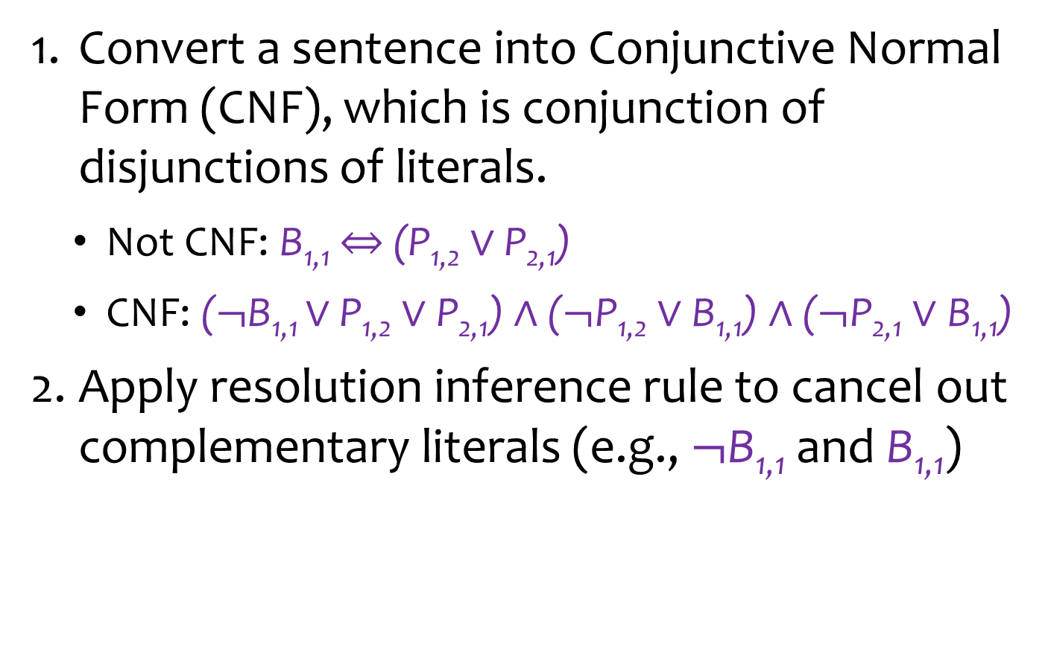
Proof by Resolution
Convert a sentence into Conjunctive Normal Form (CNF), which is conjunction of disjunctions of literals.
Not CNF: B_{1,1} $⇔$ (P_{1,2} $∨$ P_{2,1})
CNF: ($¬$B_{1,1} $∨$ P_{1,2} $∨\text{P}\text{2,1}$) $∧$ ($¬\text{P}\text{1,2}∨\text{B}\text{1,1}$) $∧$ ($¬\text{P}\text{2,1}∨\text{B}\text{1,1}$)
Apply resolution inference rule to cancel out complementary literals (e.g., $¬$B_{1,1} and B_{1,1})
Notes:
CNF = Conjunction of Disjunctions.

Slide 36
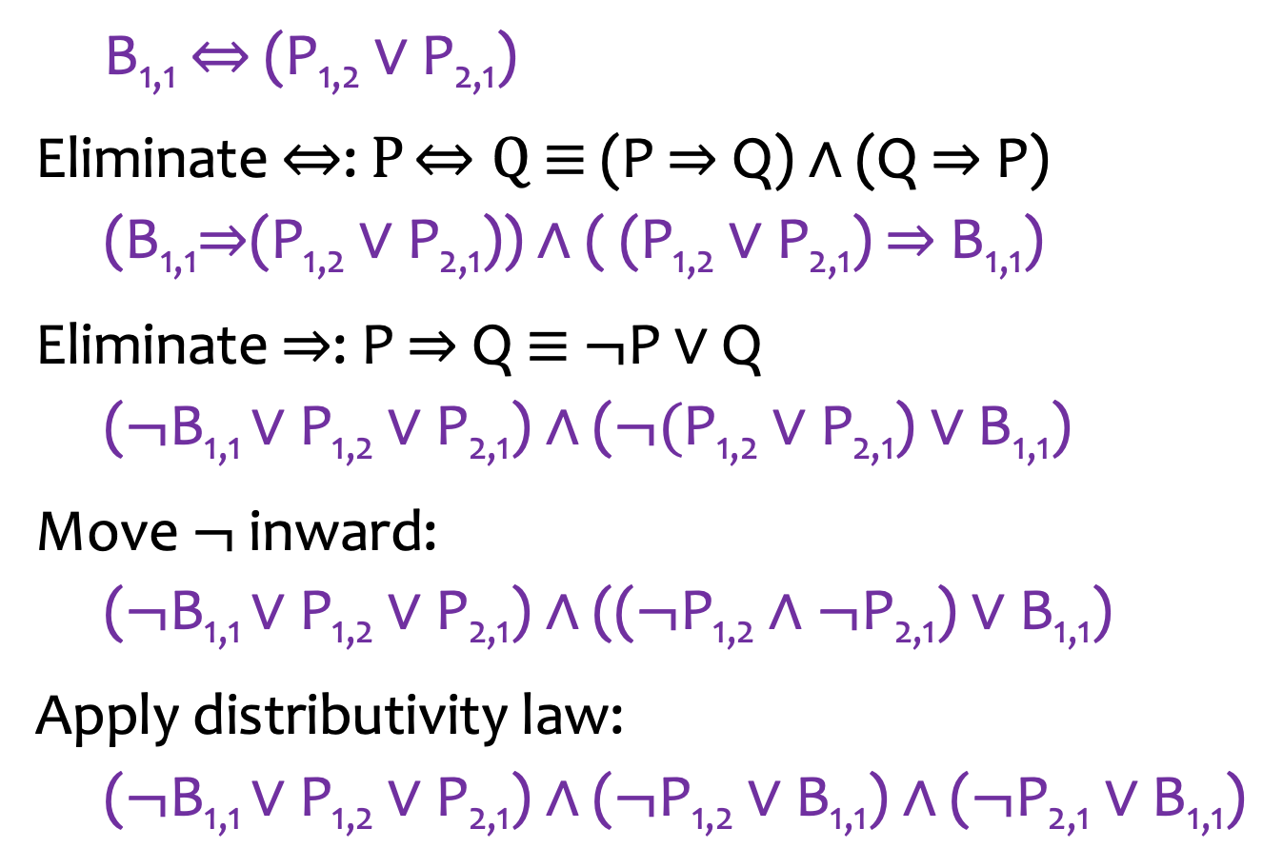
1. Converting to CNF
B_{1,1} $⇔$ (P_{1,2} $∨$ P_{2,1})
Eliminate $⇔$: $P$ $⇔Q$ ≡ (P $⇒$Q) $∧$ (Q $⇒$P)
(B_{1,1}$⇒$(P_{1,2} $∨$ P_{2,1})) $∧$ ( (P_{1,2} $∨$ P_{2,1}) $⇒$B_{1,1})
Eliminate $⇒$: P $⇒$Q ≡ $¬$P $∨$ Q
($¬$B_{1,1} $∨$ P_{1,2} $∨\text{P}\text{2,1}$) $∧$ ($¬\text{(}\text{P}\text{1,2}∨\text{P}\text{2,1}\text{)}∨\text{B}\text{1,1}$)
Move $¬$ inward:
($¬$B_{1,1} $∨$ P_{1,2} $∨\text{P}\text{2,1}$) $∧$ (($¬\text{P}\text{1,2}∧¬\text{P}\text{2,1}\text{)}∨\text{B}\text{1,1}$)
Apply distributivity law:
($¬$B_{1,1} $∨$ P_{1,2} $∨\text{P}\text{2,1}$) $∧$ ($¬\text{P}\text{1,2}∨\text{B}\text{1,1}$) $∧$ ($¬\text{P}\text{2,1}∨\text{B}\text{1,1}$)

Slide 37
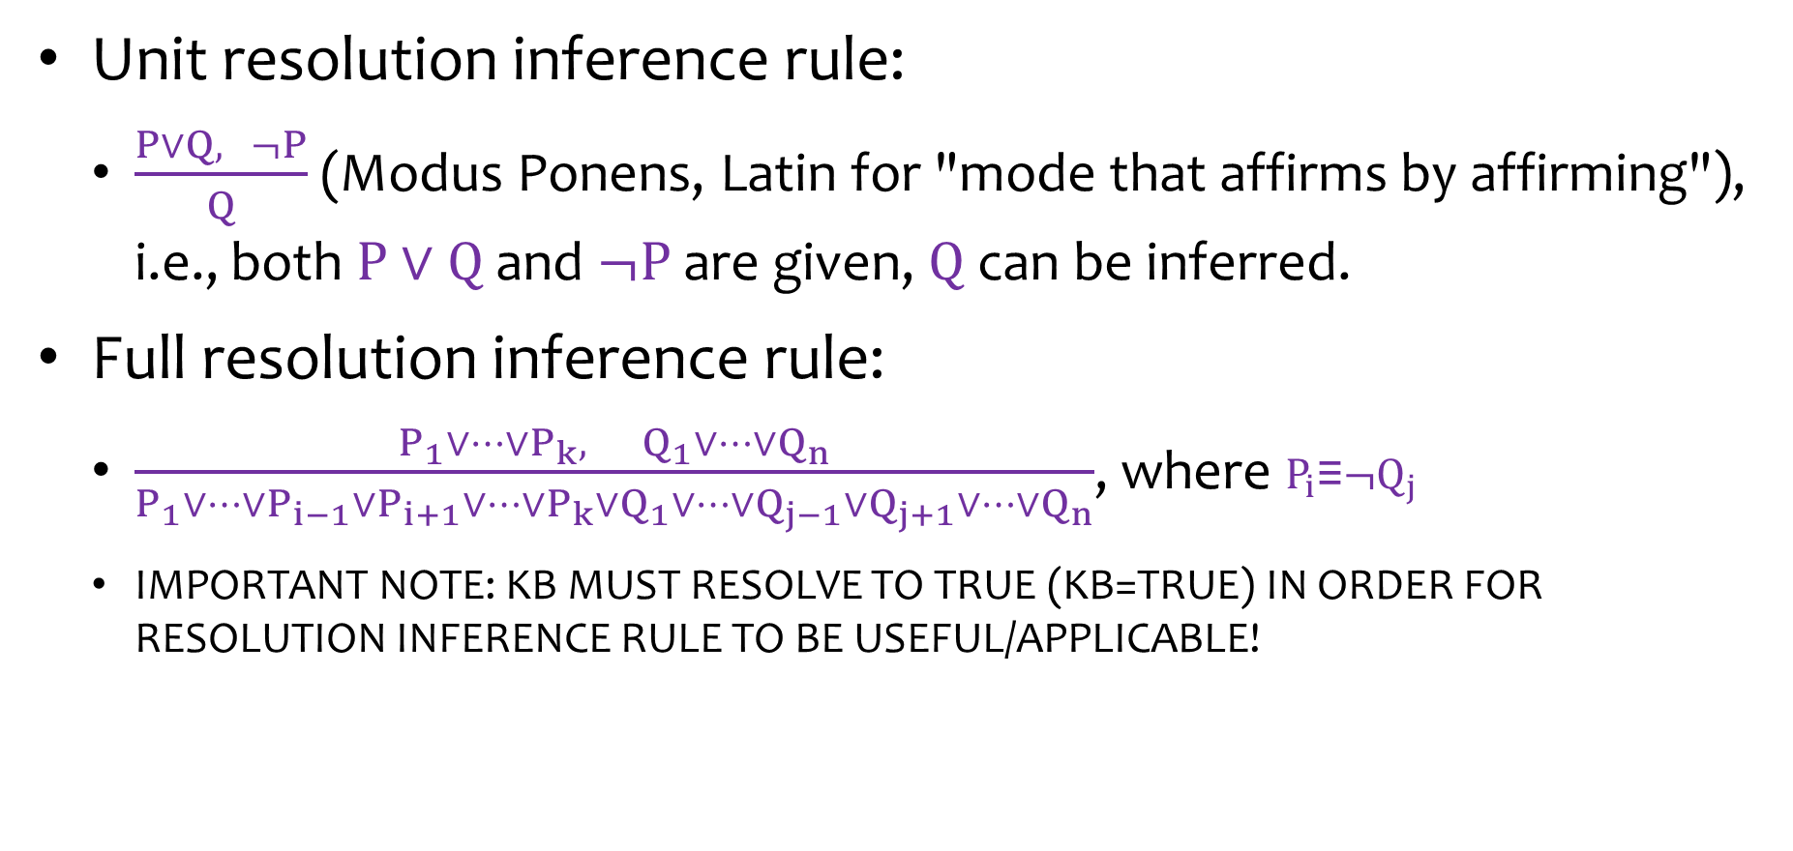
2. Applying Resolution Inference Rule
Unit resolution inference rule:
$\frac{P∨Q, ¬P}{Q}$ (Modus Ponens, Latin for "mode that affirms by affirming"), i.e., both $P∨Q$and $¬P$are given, $Q$ can be inferred.
Full resolution inference rule:
$\frac{P_{1}∨⋯∨P_{k}, Q_{1}∨⋯∨Q_{n}}{P_{1}∨⋯∨P_{i−1}∨P_{i+1}∨⋯∨P_{k}∨Q_{1}∨⋯∨Q_{j−1}∨Q_{j+1}∨⋯∨Q_{n}}$, where $P_{i}\text{≡}¬Q_{j}$
IMPORTANT NOTE: KB MUST RESOLVE TO TRUE (KB=TRUE) IN ORDER FOR RESOLUTION INFERENCE RULE TO BE USEFUL/APPLICABLE!
Notes:
Resolution inference rule allows you to generate new sentences by cancellations.
Full Resolution rule states that:
if you have a set of disjunctions (P_1 to P_k), and another set of disjunctions (Q_1 to Q_n): (P_1…P_k)^(Q_1…Q_n)
and there is a P_i and Q_j such that P_i == !Q_j (thus P_i and Q_j are complimentary)
Then you can infer the new disjunction (P_1 || P_i-1 || P_i+1 || ... P_k) || (Q_1 || Q_j-1 || Q+j+1 || ... Q_n), where P_i and Q_j have been cancelled out in this newly formed (inferred) combined conjunctive statement.

Slide 38
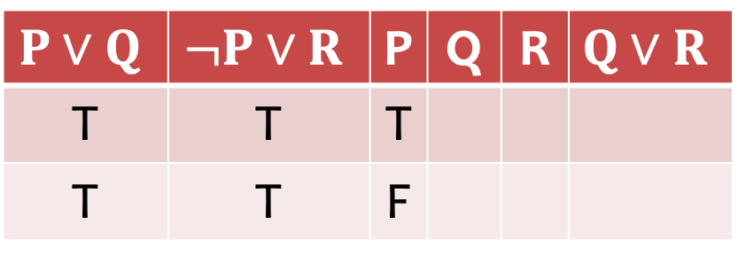
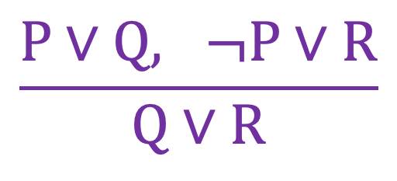
Proof through Truth Table
$$\frac{P∨Q, ¬P∨R}{Q∨R}$$
$$P∨Q$$ | $$¬P∨R$$ | P | Q | R | $$Q∨R$$
T | T | T
T | T | F
T
T
T
T
Notes:
Notice we can prove Q||R if we know P||Q and !P||R.

Slide 39
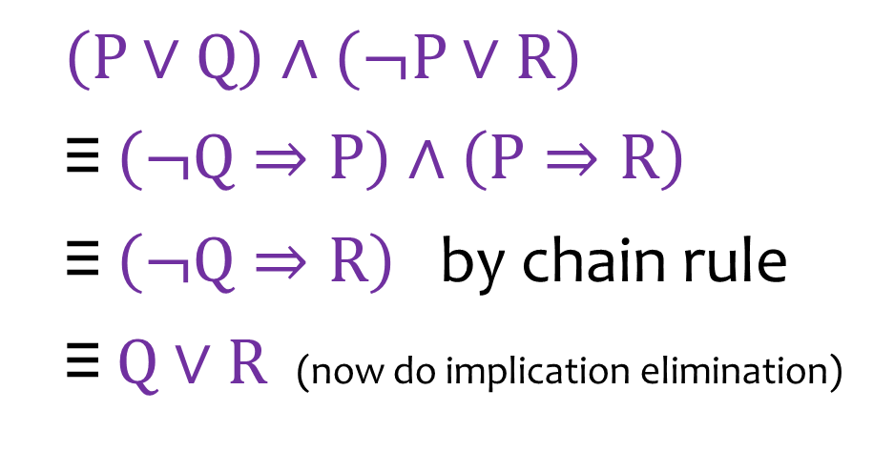
Proof through Chain Rule
$$\frac{P∨Q, ¬P∨R}{Q∨R}$$
$\left(P∨Q\right)∧\left(¬P∨R\right)$
$\text{≡} \left(¬Q⇒P\right)$ $∧\left(P⇒R\right)$
$\text{≡} \left(¬Q⇒R\right)$ by chain rule
$\text{≡} Q∨R$ (now do implication elimination)

Slide 40
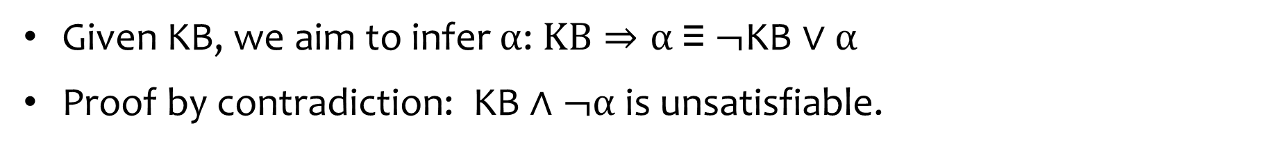
Resolution Algorithm
Given KB, we aim to infer $α$: $KB⇒α \text{≡} ¬\text{KB}∨α$
Proof by contradiction: $\text{KB}∧¬α$ is unsatisfiable.
Applying the resolution inference rule
Notes:
Proof by contradiction: prove→ !(!KB||alpha) → KB&&!alpha is impossible.
If you can do cancellation and get empty clause from P ^ !P, then you have a proof by contradiction, since KB^!alpha contains in its conjunction statement P^!P, which will always make the statement output to be FALSE, since no matter what P is, P^!P makes the entire conjunction statement ..^….^…^P^!P to be FALSE; thus if we take KB^!alpha, determine it to be FALSE, then re-negate it, thus FALSE→TRUE==!KB||alpha, which is equivalent to KB→alpha == proven TRUE; we already know KB is true; so then KB→alpha depends on alpha, and we have proven KB→alpha to be true; thus we know alpha is true!
Goal is to simplify sentences (and thus create a new, simpler sentence in the KB), by finding cancellations.
IMPORTANT NOTE: KB MUST RESOLVE TO TRUE (KB=TRUE) IN ORDER FOR RESOLUTION INFERENCE RULE TO BE USEFUL/APPLICABLE! Otherwise KB→alpha when KB=false always resolves to TRUE but will not tell us alpha nor can we infer (build a truth table to prove it! → KB must be true in order to make such an inference about alpha).
REMEMBER: A → B means if A is true then B is true: so we aim to infer alpha, KB→alpha, means KB MUST BE TRUE → if KB is true then Alpha is true, then we aim to infer Alpha (which could be T or F if KB is true; so we need to infer it).
Boolean Satisfiability Problem
Satisfiable : If the Boolean variables can be assigned values such that the formula turns out to be TRUE, then we say that the formula is satisfiable. Unsatisfiable : If it is not possible to assign such values, then we say that the formula is unsatisfiable

Slide 41
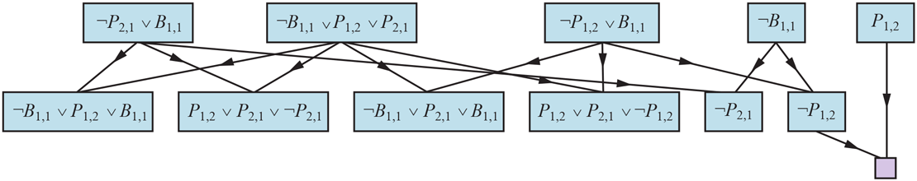
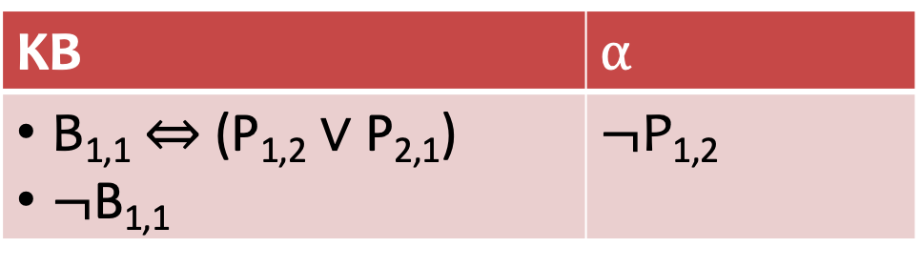
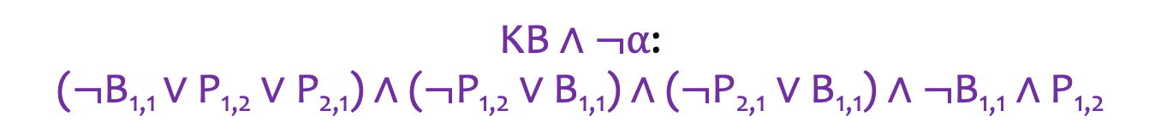
Example
KB | $$α$$
B_{1,1} $⇔$ (P_{1,2} $∨$ P_{2,1}) $¬$B_{1,1} | $$¬\text{P}\text{1,2}$$
$\text{KB}∧¬α$:
($¬$B_{1,1} $∨$ P_{1,2} $∨\text{P}\text{2,1}$) $∧$ ($¬\text{P}\text{1,2}∨\text{B}\text{1,1}$) $∧$ ($¬\text{P}\text{2,1}∨\text{B}\text{1,1}$) $∧¬$B_{1,1} $∧\text{P}\text{1,2}$

Slide 42
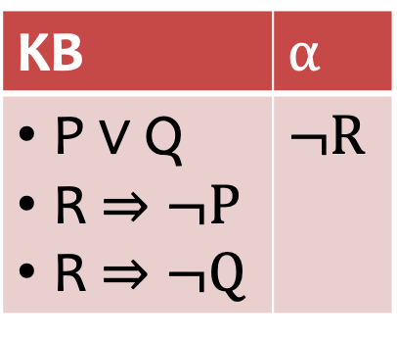
Quiz
KB | $$α$$
P $∨$ Q R $⇒¬P$ R $⇒¬Q$ | $$¬R$$

Slide 43











Quiz: Solution
KB | $$α$$
P $∨$ Q R $⇒¬P$ R $⇒¬Q$ | $$¬R$$
$\text{KB}∧¬α$:
($P∨$ Q) $∧$ ($¬R∨¬P$) $∧$ ($¬R∨¬Q$) $∧R$
$P∨$ Q
$$¬R∨¬P$$
$$¬R∨¬Q$$
$$R$$
$Q∨$ $¬R$
$P∨$ $¬R$
$$¬P$$
$$¬Q$$
$$¬R$$
$$¬R$$
Notes:
This is much better than brute force; and does not take up so much time or space.

Slide 44
Speedup the Algorithm
The complexity of the resolution algorithm takes polynomial time.
We can design linear-time algorithms for some restricted forms of propositional logic.

Slide 45
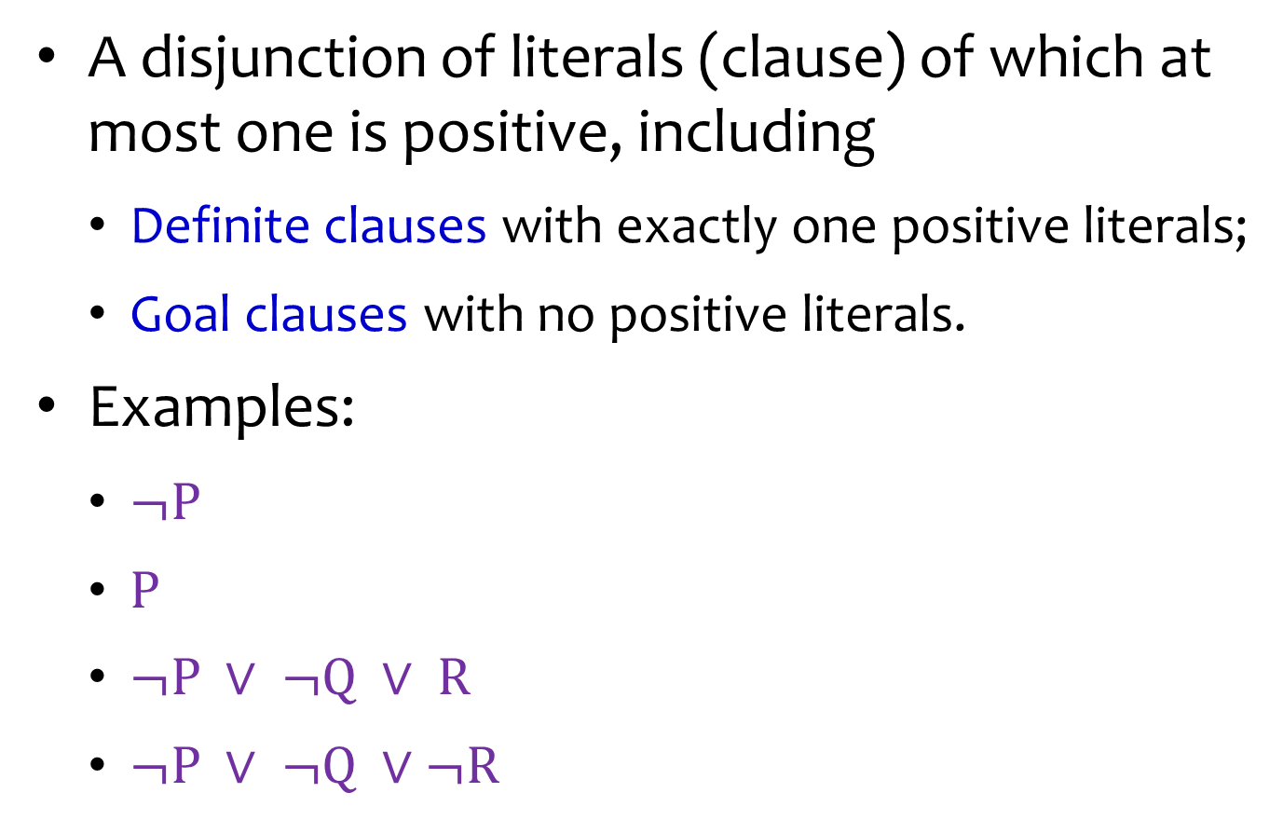
Horn Clauses
A disjunction of literals (clause) of which at most one is positive, including
Definite clauses with exactly one positive literals;
Goal clauses with no positive literals.
Examples:
$¬P$
$P$
$¬P ∨ ¬Q ∨ R$
$¬P ∨ ¬Q ∨¬R$

Slide 46

Different Perspective of Horn Clauses
Either: symbol
$\text{P}$
$¬Q$
Or: (conjunction of symbols) $⇒$ symbol
$¬\text{P}∨¬Q∨\text{R}$ ≡ $¬\text{(}\text{P}∧\text{Q}\text{)}∨\text{R}$ ≡ $\text{P}∧Q⇒\text{R}$
Notes:
We can use horn clause with chain rule to be able to solve an inference in linear time.

Slide 47

Forward Chaining
Resolution for Horn clauses (Modus Ponens):
$$\frac{P_{1}, …,{ P}_{n}, (P_{1}∧…∧P_{n})⇒Q}{Q}$$

Slide 48
Forward Chaining

Slide 49
Example
Query Q
Notes:
We can use chain rule to prove the value of Q

Slide 50
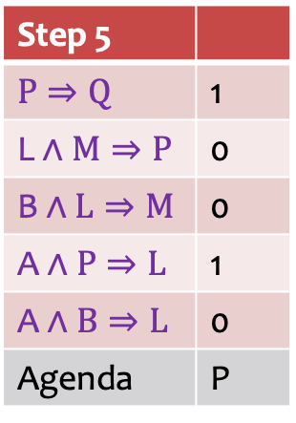
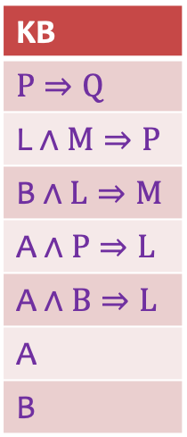
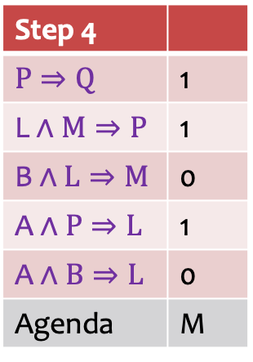
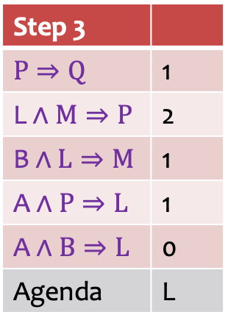
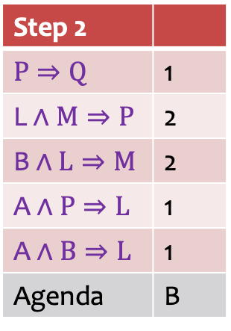
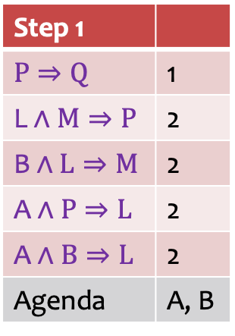
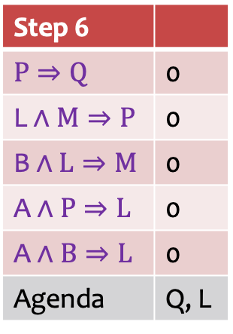
Example: Solution in Table
Step 1
$$P⇒\text{Q}$$ | 1
$$\text{L}∧M⇒\text{P}$$ | 2
$$\text{B}∧L⇒\text{M}$$ | 2
$$\text{A}∧P⇒\text{L}$$ | 2
$$\text{A}∧B⇒\text{L}$$ | 2
Agenda | A, B
Step 2
$$P⇒\text{Q}$$ | 1
$$\text{L}∧M⇒\text{P}$$ | 2
$$\text{B}∧L⇒\text{M}$$ | 2
$$\text{A}∧P⇒\text{L}$$ | 1
$$\text{A}∧B⇒\text{L}$$ | 1
Agenda | B
Step 3
$$P⇒\text{Q}$$ | 1
$$\text{L}∧M⇒\text{P}$$ | 2
$$\text{B}∧L⇒\text{M}$$ | 1
$$\text{A}∧P⇒\text{L}$$ | 1
$$\text{A}∧B⇒\text{L}$$ | 0
Agenda | L
KB
$$P⇒\text{Q}$$
$$\text{L}∧M⇒\text{P}$$
$$\text{B}∧L⇒\text{M}$$
$$\text{A}∧P⇒\text{L}$$
$$\text{A}∧B⇒\text{L}$$
$$\text{A}$$
$$\text{B}$$
Step 4
$$P⇒\text{Q}$$ | 1
$$\text{L}∧M⇒\text{P}$$ | 1
$$\text{B}∧L⇒\text{M}$$ | 0
$$\text{A}∧P⇒\text{L}$$ | 1
$$\text{A}∧B⇒\text{L}$$ | 0
Agenda | M
Step 5
$$P⇒\text{Q}$$ | 1
$$\text{L}∧M⇒\text{P}$$ | 0
$$\text{B}∧L⇒\text{M}$$ | 0
$$\text{A}∧P⇒\text{L}$$ | 1
$$\text{A}∧B⇒\text{L}$$ | 0
Agenda | P
Step 6
$$P⇒\text{Q}$$ | 0
$$\text{L}∧M⇒\text{P}$$ | 0
$$\text{B}∧L⇒\text{M}$$ | 0
$$\text{A}∧P⇒\text{L}$$ | 0
$$\text{A}∧B⇒\text{L}$$ | 0
Agenda | Q, L
Notes:
The right column gives the number of unknown symbols on the left side of each implication.
At each step, one of the symbols on the agenda is revealed, which eventually moves some of the statements towards 0 elements unknown on the left side.

Slide 51
Example: Solution in Graph
Query Q

Slide 52
Example: Solution in Graph (cont’d)
Red ring: facts unapplied
Red disk: facts applied

Slide 53
Summary: Forward Chaining
Counts the unknown premises in all clauses.
Decrease the count if a premise is known.
When a count becomes zero, the conclusion is added as a known fact.
Record the inferred symbols to avoid redundant work.

Slide 54
Backward Chaining
Work backwards from the query Q.
If Q is known, done.
Otherwise, check its premise P.
Next step check L and M.
Avoid loops: check if new sub-goal is already on the goal stack.
Avoid repeated work: check if new sub-goal has already been proved true or failed.

Slide 55
Example
green ring: checking
green disk: checked
Red disk: facts

Slide 56
Forward vs. Backward Chaining
Both time complexities are linear to the size of KB.
Forward chaining is data-driven, and may do lots of work that is irrelevant to the goal.
Backward chaining is goal-driven, and can be much less than linear in terms of time complexity.

Slide 57
Pros and Cons of Propositional Logic
Pros
It is declarative: pieces of syntax correspond to facts.
It is compositional and allows partial, disjunctive, or negated information: unlike most data structures and databases.
Meaning is context-independent: unlike natural language.
Cons
It has very limited expressive power: unlike natural language
E.g., cannot say “pits cause breezes in adjacent squares” except by writing one sentence for each square.
Notes:
You cannot express natural language using propositional logic; need first-order logic for this.

Slide 58
Outline
Knowledge-based Agents
Propositional Logic
First-Order Logic

Slide 59
Combining the Best of Formal and Natural Languages
When we look at the syntax of natural language, the most obvious elements are
nouns and noun phrases that refer to objects (squares, pits, wumpuses)
verbs and verb phrases that refer to relations among objects (is breezy, is adjacent to, shoots). Some of these relations are functions -- relations in which there is only one “value” for a given “input.”

Slide 60
First-Order Logic (FOL)
Propositional logic assumes world contains
Facts
First-order logic (like natural language) assumes the world contains
Objects: people, houses, numbers, theories, Ronald McDonald, colors, baseball games, wars, centuries, …
Relations: red, round, bogus, prime, multistoried, brother of, bigger than, inside, part of, has color, occurred after, owns, comes between, …
Functions: father of, best friend, third inning of, one more than, end of, …

Slide 61
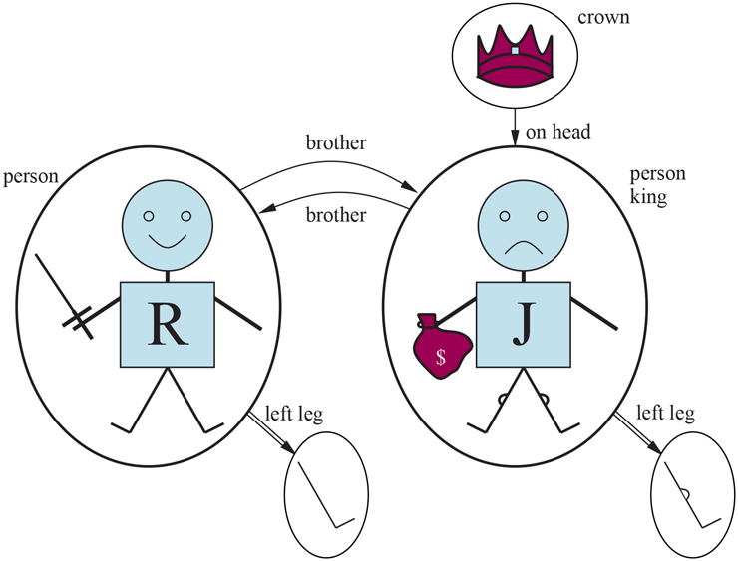
Example: Model for FOL
Five objects:
Richard the Lionheart, King of England (1189-1199);
His younger brother John, the evil King (1199-1215);
Their left legs;
A crown.
Relations (tuples):
Brotherhood: ⟨Richard, John⟩, ⟨John, Richard⟩
“on head” relation: ⟨the crown, John⟩
Functions:
“left leg”: ⟨Richard⟩ → Richard’s left leg; ⟨John⟩ → John’s left leg

Slide 62
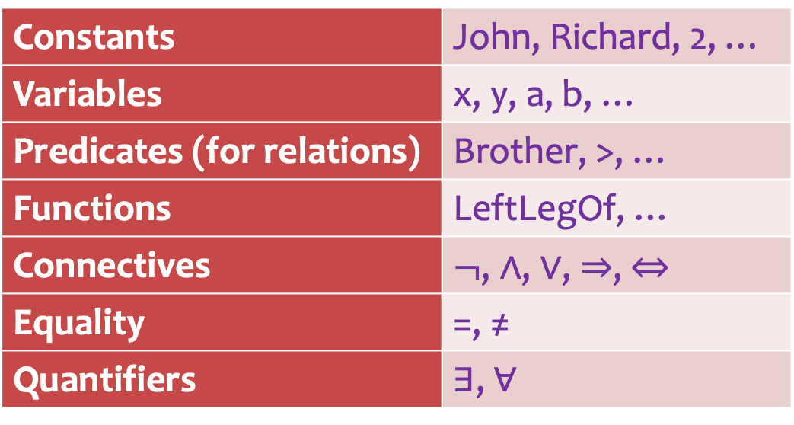
Syntax of FOL: Basic Elements
Constants | John, Richard, 2, …
Variables | x, y, a, b, …
Predicates (for relations) | Brother, >, …
Functions | LeftLegOf, …
Connectives | $¬$, $∧$, $∨$, $⇒$, $⇔$
Equality | =, ≠
Quantifiers | ∃, ∀

Slide 63
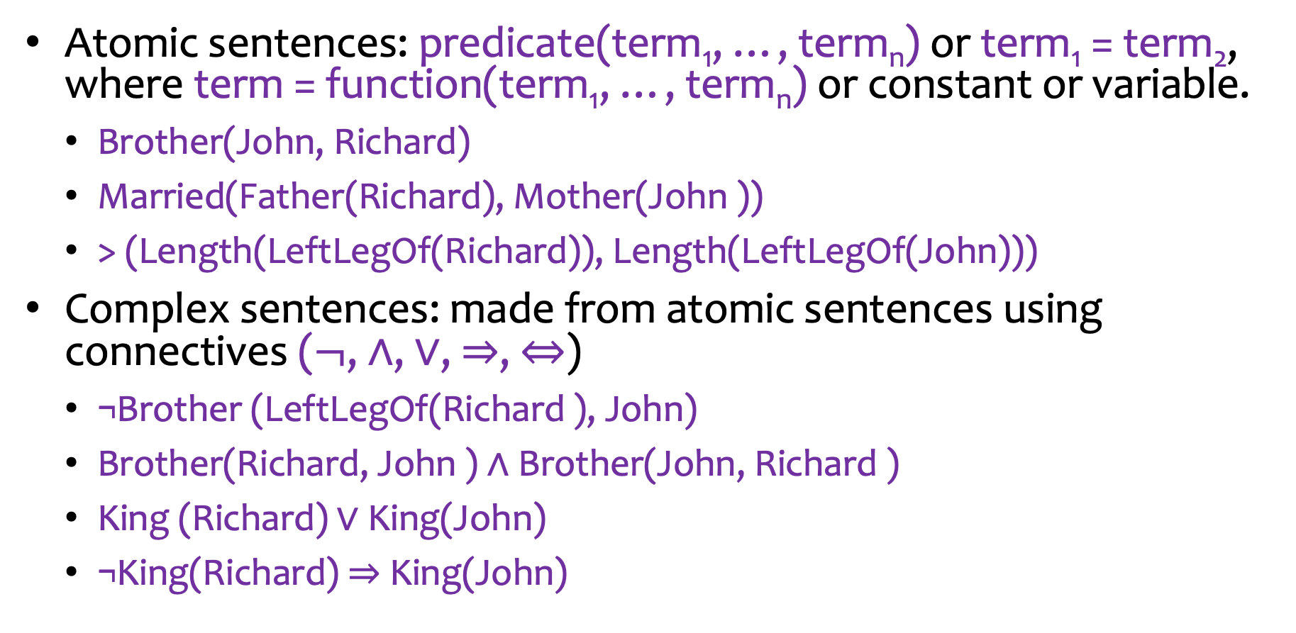
Sentences
Atomic sentences: predicate(term₁, …, term_{n}) or term₁ = term₂, where term = function(term₁, …, term_{n}) or constant or variable.
Brother(John, Richard)
Married(Father(Richard), Mother(John ))
> (Length(LeftLegOf(Richard)), Length(LeftLegOf(John)))
Complex sentences: made from atomic sentences using connectives ($¬$, $∧$, $∨$, $⇒$, $⇔$)
¬Brother (LeftLegOf(Richard ), John)
Brother(Richard, John ) ∧ Brother(John, Richard )
King (Richard) ∨ King(John)
¬King(Richard) ⇒ King(John)

Slide 64
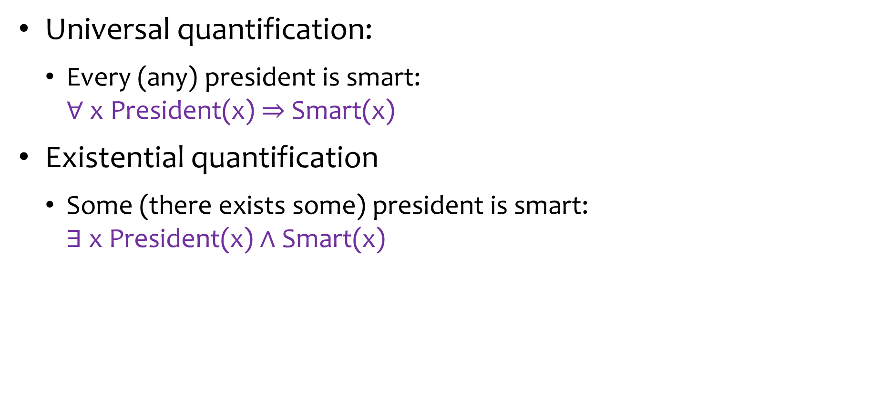
Quantifiers
Universal quantification:
Every (any) president is smart: ∀ x President(x) $⇒$Smart(x)
Existential quantification
Some (there exists some) president is smart: ∃ x President(x)$∧$Smart(x)

Slide 65
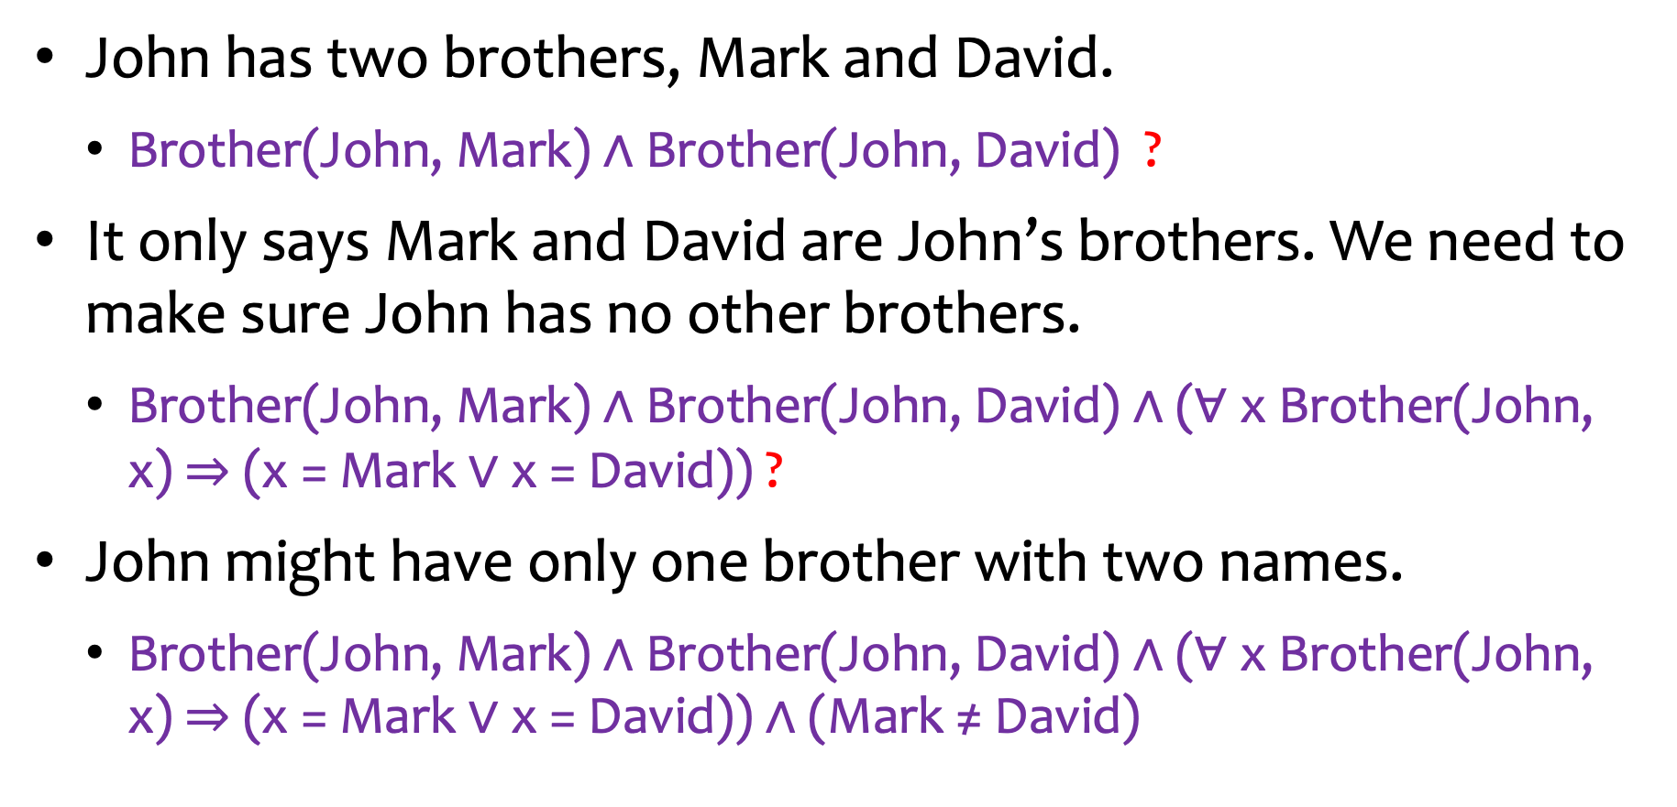
Expressing with FOL
John has two brothers, Mark and David.
Brother(John, Mark)$∧$ Brother(John, David) ?
It only says Mark and David are John’s brothers. We need to make sure John has no other brothers.
Brother(John, Mark)$∧$ Brother(John, David)$∧$ (∀ x Brother(John, x)$⇒$ (x = Mark $∨$x = David)) ?
John might have only one brother with two names.
Brother(John, Mark)$∧$ Brother(John, David)$∧$ (∀ x Brother(John, x)$⇒$ (x = Mark $∨$x = David)) $∧$ (Mark ≠ David)

Slide 66
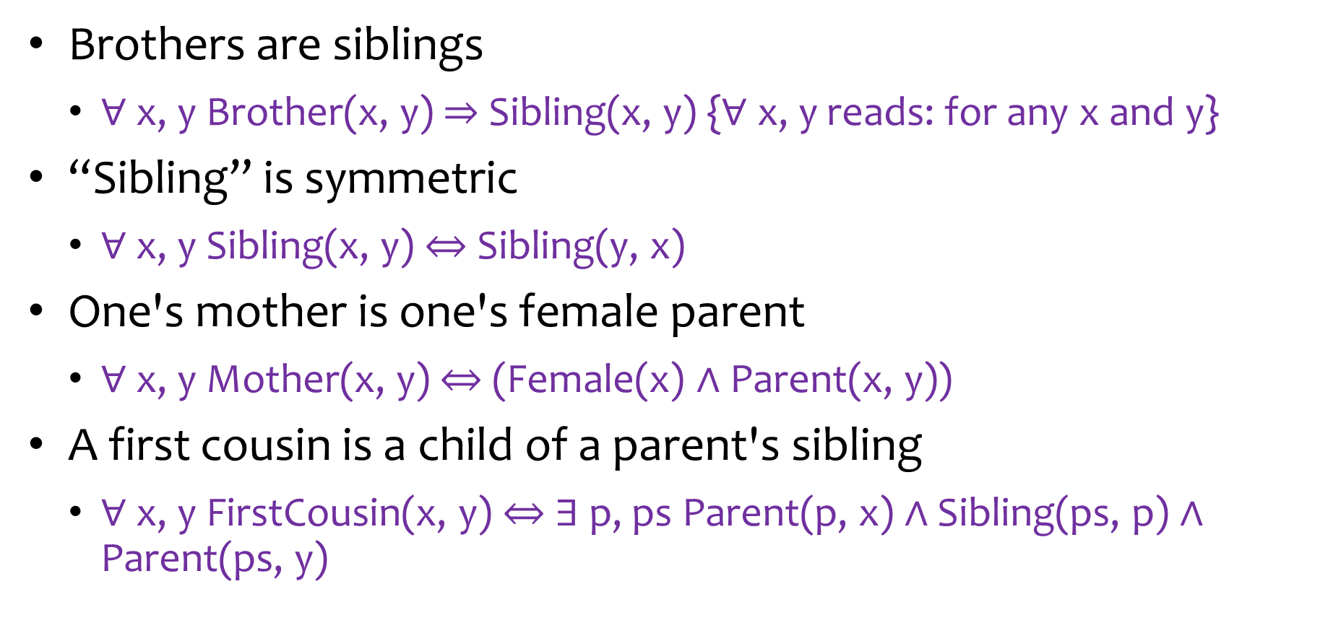
Fun with FOL
Brothers are siblings
∀ x, y Brother(x, y) $⇒$Sibling(x, y) {∀ x, y reads: for any x and y}
“Sibling” is symmetric
∀ x, y Sibling(x, y) $⇔$ Sibling(y, x)
One's mother is one's female parent
∀ x, y Mother(x, y) $⇔$ (Female(x) $∧$ Parent(x, y))
A first cousin is a child of a parent's sibling
∀ x, y FirstCousin(x, y) $⇔$∃ p, ps Parent(p, x) $∧$ Sibling(ps, p) $∧$ Parent(ps, y)

Slide 67
Interacting with FOL KBs
Assertions: sentences are added to a knowledge base using Tell.
Tell(King(John)) {“john is king”}
Tell(Person(Richard)) {“Richard is a person”}
Tell(∀ x King(x) ⇒ Person(x)) {“for any x, x is a king, then the king is a person”}
Queries/goals: we can ask questions of the knowledge base using Ask.
Ask(King(John)): return True
AskVars(Person(x)): return a substitution or binding list {x/John} and {x/Richard}.

